Slide 2
Asepsis: Sterilization and Disinfection

Slide 3
Antisepsis: prevention of infection of tissues or body surfaces by application of non- antibiotic chemicals (antiseptics).
Sterilization: destruction or removal of all living organisms including spores.
Disinfection: destruction of pathogenic organisms, not including spores , usually by chemicals (disinfectants).

Slide 4
sterilization has wide application in
bacteriological laboratory
hospitals for surgery
food industry

Slide 5
There are different methods of sterilization : 1- Physical methods -heating: either moist heat or dry heat -Radiation 2-Chemical methods :A-Halogens B-Alcohols C- Heavy metals D-Alkylating agents E-Phenol and phenol derivatives F- acids and alkalines G-Oxidysing agents 3- Mechanical methods -filtration
Methods of sterilization

Slide 6
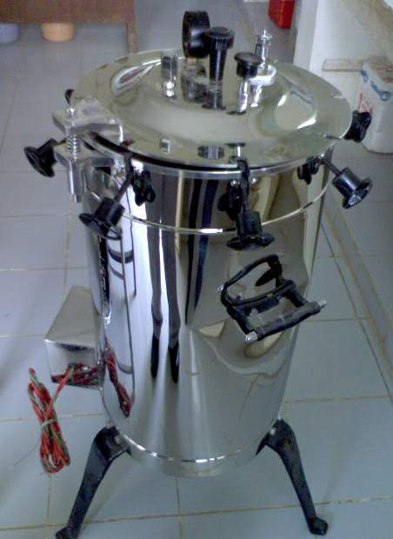
1.Heat A- Moist heat
1.pasteurisation:kill particular spoilage organisms or pathogens in heat susceptible fluid as applicable for milk .temperature used between 60-70°C.
2. Boiling or steaming: at 100°C for 20minutes.It kills all vegetative organisms and viruses but not spores.
3.Autoclaving : exposure of heat resistant materials to saturated steam with temperature exceeding 100°C (121°C) under pressure for 20 minutes. It kills both vegetative organisms and spores .this is the most effective method of destruction of bacterial spores. All materials not spoiled by heat can be subjected to autoclaving , e.g. culture media, rubber goods, instruments , gowns, dressings.

Slide 7
B-Dry heat
1-Hot air sterilization :this is employed by the use of hot air oven where the temperature is usually maintend at 170°C for 60 minutes or 180°C for 30 minutes .this is effective against spores. Dry heat is used for sterilization of glassware, empty petri-dishes ,glass syringes , oils and oily injections .this cannot be used for rubber and plastic gloves which are damaged at this temperature.
2-burning or incineration : used for soiled dressings, laboratory media (used) and human tissues .
3-flaming: used for sterilization of wire loops and glass rods in microbiological laboratories .

Slide 8
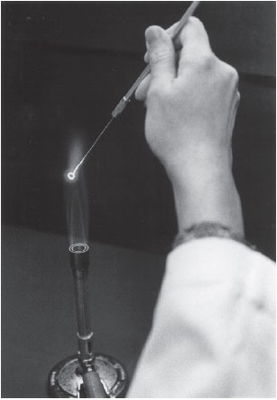
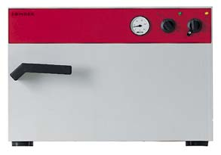
oven
wire loops

Slide 9
-Irradiation:
A-Ionizing radiation: includes X-rays and gamma rays,have more energy and penetrating power than UV ,used to sterilize pharmaceuticals and disposable medical supplies such as syringes, surgical gloves , catheters and sutures.
B-Ultraviolet radiation :microbicidal activity of ultraviolet(UV) light depends on :
_length of exposure
_wavelength of UV (260nm-270nm)
ӾVery poor penetrating power
Ӿdamage the eyes ,cause burns, and cause mutation in cells of the skin
ӾIt is mainly used in disinfection of operation theatre.

Slide 10
2- Chemicalis
By using disinfectants and antiseptics to control microorganisms.
Mode of action :
Ӿ damage the lipids and/or proteins of the semi-permeable cytoplasmic membrane of microorganisms resulting in leakage of cellular materials needed to sustain life.
Ӿ denature microbial enzymes and other proteins by disrupting the hydrogen and disulfide bonds.
The important groups are:
A-Halogens
B-Alcohols
C- Heavy metals
D-Alkylating agents
E-Phenol and phenol derivatives
F- acids and alkalines
G-Oxidysing agents
`

Slide 11
A- Halogens
Capable of killing bacteria , spores and viruses.
1- Chlorine:reacts with water to form hypochlorite ions , which in turn denature microbial enzymes. Used in water supplies ,swimming pools, wards and clean utensils.
2-Iodine and idiophores : iodine used in alcohol 70% as tincture of iodine (iodine2.5%)for skin antisepsis,
Idophores, organic povidone iodine used as antiseptic and hand wash.
B-Alcohols:
Kill vegetative bacteria rapidly but have no action on spores .
Ethyl alcohol (ethanol)used at 75% in water as skin antiseptic and surface disinfectant .

Slide 12
C-Heavy metals:
-Mercury compounds (mercurochrome) are bacteriostatic, ineffective against endospores ,
-Silver nitrate (1%).
D-Alkylating agents:
Are capable of killing bacteria ,spores and viruses. These can be used as alternative for heat treatment methods.
Formaldehyde (formalin)(37%aqueous solution of formaldehyde gas),used for instruments and machines . Causes hypersensitivity
Glutaraldehyde: kill vegetative bacteria in 10-30 minutes and endospores in about 4 hours.

Slide 13
E-Phenol and phenol derivatives:
Ineffective against endospores.
Chlorhexidine with cetrmide (Savlon) is used widely for burns,wounds, for surgical instruments and preoperative disinfection of skins.
Hexachlorophane (Dettol) is active against gram positive cocci. As Used as hand wash for prevention of staphylococcal infection.
F- acids and alkalines :
_salts of organic acids: food presevative.
_undecylenic acid : dermatophyte infections
G-Oxidysing agents:
Hydrogen peroxide and potassium permanganate have weak antibacterial activity.

Slide 14
-Gasseous process
Ethylene Oxide:
is a gas at room temperature .it is an alkylating agent which has a lethal effect on bacterial protein . Although it is inflammable, it forms a non-inflammable mixtures with carbon dioxide .it has a `good penetration power even through plastics.
Useful for plastic catheters, fragile and heat sensitive equipments ,rubber tubing.

Slide 15
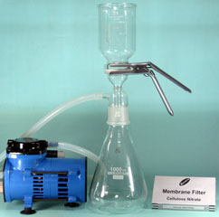
3- Filtration
Sterilize solutions that may be damaged or denatured by high temperatures or chemical agent s such as antibiotic solutions ,sera , carbohydrate and sugar solutions used for preparation of culture media.

Slide 16
Factors influencing antimicrobial activity
-the concentration and kind of a chemical agent used
-the length of exposure to the agent
The number of microorganisms present
The species or strain of microorganism
The nature of the material bearing the microorganisms
The temperature at which the agent is used
The intensity and nature of physical agent used

